Slide 1




Slide 2
Goals for the Webinar
Brief Overview of Project NCHS Embargo Restrictions Prepare for Public Release

Slide 3
About this Project
United States Small-Area Life Expectancy Estimates Project (USALEEP) is funded by Robert Wood Johnson Foundation
NAPHSIS partnered with the National Center for Health Statistics (NCHS) to produce life expectancy estimates - or the average number of years a person can expect to live - in each census tract in the United States
These estimates will complement other measures of health at the county, state, and national levels, by providing a measure of life expectancy at the community level

Slide 4
Project Objectives
Data sharing agreements established
Data transmitted securely
Geocodes assigned
Methodology developed
Return geocoded data to jurisdictions
Release life expectancy estimates

Slide 5

Data Sharing Agreements
Model data sharing agreement developed and shared with jurisdictions
52 of 57 jurisdictions shared decedent residence address information with NCHS for use on this project
Data Transmission
File format created and data transmitted securely to NCHS
Six years of data which included 2010 - 2015

Slide 6
Geocoding
All data geocoded using the same methodology
Methodology
Life expectancy estimates were calculated by constructing a life table for each census tract
The estimate is a summary measure that is based on the number of deaths and age at death of the residents in each census tract during the years 2010-2015
Life tables are computed using death certificate data and population estimates from both the 2010 U.S. census and the 2011-2015 American Community Survey

Slide 7

Release of Geocoded Data/Estimates
Geocoded data was made available to States
Life expectancy estimates and life tables - release set for September10

Slide 8

TENTATIVE RELEASE DATES AND WEBINAR DATES
Early July
Embargoed USALEEP estimates and geocoded data made available to Vital Records Offices
July 18, 2018
Webinar on Life Expectancy at Birth Methodology
July 24, 2018
Communications Webinar for Vital Records Offices
Mid - August
USALEEP Estimates Launch

Slide 9
Thoughts on Maximizing State Response to USALEEP
Who should know what is coming? What do they need to hear?
What needs to be decided? Can you track change?
14

Slide 10
Who Should Know
Administration
Local Health
  State and Local
Chronic Disease
Family Health Services
Life Course Epidemiology
Medicaid
Communications
Environmental Quality
15

Slide 11
Michigan’s Local Health Departments
32 single county, 12 district (i.e. multi-county) and one city health department (Detroit) collectively covering Michigan’s 83 counties.
Delegated MDHHS authority for Public Health Code.
Legally required to have a Health Officer and Medical Director (may be same person).
Vary in size from approximately 25 staff to almost 500 staff
Provide coverage for service population ranging from 50,000 to over 1,000,000 persons.
May or may not report to a Board of Health in addition to County/City governance structure.
16

Slide 12
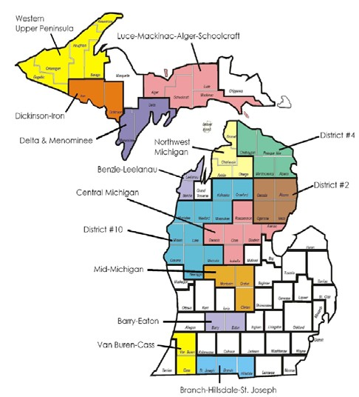
A local health department shall:
(summarized from Michigan Public Health Code)
Implement and enforce laws
regarding local health
Utilize vital and health statistics
for the purpose of protecting the
public health
Make investigations and inquiries
as to the causes of disease,
morbidity and mortality, and
especially of epidemics
Plan, implement, and evaluate
health education.
Plan, implement, and evaluate
nutrition services
All vary as to amount and level of
services
17

Slide 13
Local Health Connections
Office of Local Health Services
Michigan Association of Local Public Health
Public Health Administrators
Environmental Health
Epidemiological/Analytical Staff
18

Slide 14
What do they need to hear
What is this?
  Big Picture
  Little Picture
Why is this different?
How might this change health planning?
When is it coming?
What is next?
19

Slide 15
Project Background
Goal: Produce estimates of life expectancy at birth for every Census tract in the United States.
An increasing body of research is recognizing the importance of measuring mortality outcomes at the local level to the identification of health disparities within a population
The indicator most widely identified as the ideal measure of a population’s mortality experience is life expectancy at birth.
Its estimation is complex. It requires the calculation of a life table that includes six distinct functions and a minimum number of age groups and total population size below which the estimates become unstable and unreliable.
20

Slide 16

Project Strengths
National scope
Nearly every VRO already participating
Uniformity
Consistent geocoding
Standardized CTLE methodology
Sustainability
Future VSCP contract?
21

Slide 17



Building a Measure of Health at a Community Level
Census Tract Life Expectancy at Birth
Donald F. Schwarz, MD, MPH, MBA Robert Wood Johnson Foundation

Slide 18

We Can’t Change What We Can’t Measure
No population health indicators available below county level (census tract) nationwide
County level data obscure geographic differences within counties
Nationally, no temporal or cross- sectional comparisons for census tract level health status
23

Slide 19

Current Situation
Community health data essential
Community health indicators not uniformly available nationwide
No sub-county life expectancy estimates for large parts of US
Existing sub-county level life expectancy estimates not comparable
24

Slide 20
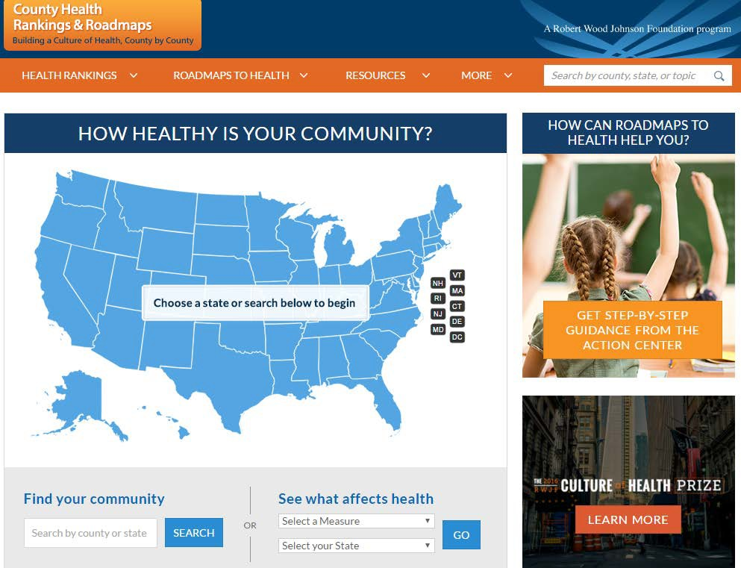
Currently, health data are available at the county level
25

Slide 21



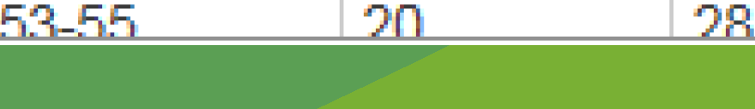
Select a Ranking :
Philade lphia (PH)
County Snapshot I Additional Measures
HEALTH OUTCOMES
f':':\
Areas to Explore ON
OVERALL RANK D
1
Philadelphia TrendO County
Error Margin
County
Health Outcomes
Length of Life
Premature death
67
65
1
Union (UN)
2 Centre (CE)
•
3
4
5
6
7
8
9
10
11
Juniata (JU}
10,151
9,974- 10,327 5,200
6,926
Chester (CH)
66
Quality of Life
Poor or fair health
Poor physical health days
Poor mental health days Low birthweight
Health Factors 67
Health Behaviors 64
Cumberland (CU)
20%
4.4
4 . 6
11-1%
19-22%
4.1-4.7
4 . 3- 4.9
11.0-11 _3%
10%
2.5
2.3
5 _9%
14%
3_ 5
Montgome[Y (MD
Sny:der(SN)
3.6
8 _ 3%
Lancaster (LN)
Butler(BD
Pike (Pll Lebanon (LE)
12 | Bucks (BU) | Adult smoking | 23% | 22-25% | 14% | 20%
13 Bedford (BO) _{Adult obesity} |  |  | 30% | 29-31% | 25% | 29%
Bradford (BF) Cameron {CM) |  | Food environment index 6.3 8-4 7_ 7 +
16 | Tioga {Tl) | Physical inactivity | 27% | 26-28% | 20% | 24%
17 | Adams (ADJ | Access to exercise opportunities | 100% |  | 92% | 85%
18 | Franklin (FR) | Excessive drinking | 17% | 16-19% | 10% | 17%
York(YO) Berks (BR) |  | + Alcohol-impaired driving deaths 26% 14% 34% + Sexually transmitted infections 1,344 138 431
21 | Lehigh (LH) | 1

Slide 22
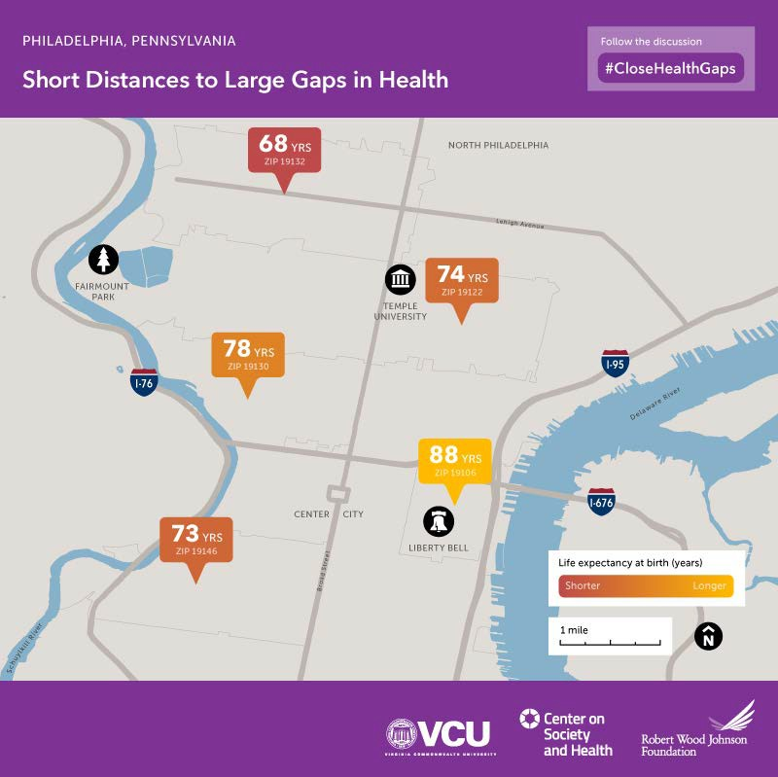
In four miles, infants lose 20 years of life

Slide 23
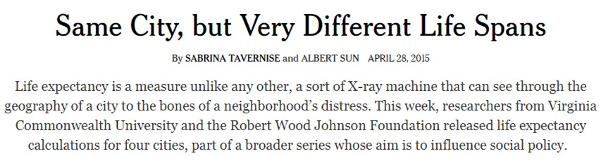
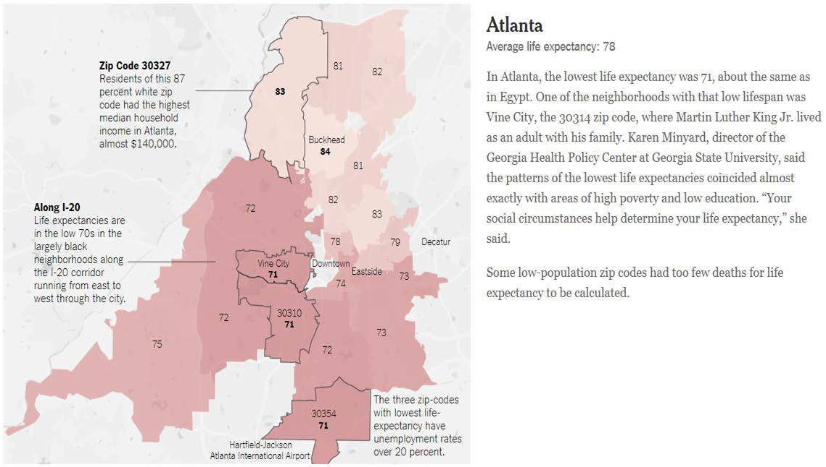
28

Slide 24
What will this project mean for states?
Potential for new federal investment in health
Create national standard for geocoding of deaths
Census tract life expectancy can be compared across jurisdictions within and across states
Geocoded deaths available for vital statistics work
29

Slide 25

Project Significance
Groundbreaking
Community development funding
Improve health of all Americans regardless of place of residence
Raise awareness of health disparities at community level
Sustainability
30

Slide 26
Spark Thinking on Use
Community Health Assessment
Untangling effects on social determinates of health
Targeting health initiative below county level
Examples of local health assessment activities
  Underserved populations
  Teen births
  Neighborhood health
  Infant mortality
  Pediatric telehealth through school clinics
  Justify funding
31

Slide 27
Data and Methodological Challenges
Mortality data for small areas
In the United States, the smallest geographic identifier available nationally for mortality data is the county of residence of decedents.
6 years of geocoded deaths (2010-2015) at census tract level
Population data for small areas
Census Bureau does not produce postcensal or intercensal population estimates below county level
Small population sizes and death counts
Below a certain size/number life table estimates are unreliable and unstable
How small can populations or death counts be in order to produce reliable life expectancy estimates?
32

Slide 28
Data and Methodological Challenges
Mortality data
Fifty-three registration areas, all 50 U.S. states, New York City, Washington, D.C. and Puerto Rico, provided to NCHS usable residential address information for all deaths that occurred in their jurisdictions in years 2010 through 2015.
Through a collaborative agreement between NCHS and the Department of Housing and Urban Development (HUD), residential addresses were geocoded by HUD Geocode Service Center (GSC) to identify their corresponding census tract codes.
Population data
Based on the years of geocoded mortality data, the only population data available to estimate age-specific death rates is sample-based and contains significant error.
Combine the 2010 Decennial Census with the 2011-2015 ACS.
Use 1/6 of the 2010 Census and 5/6 of the ACS: reduces the variance of the population estimates by a 1/6 because the 2010 Census is a complete count, not a sample as the ACS.
33

Slide 29
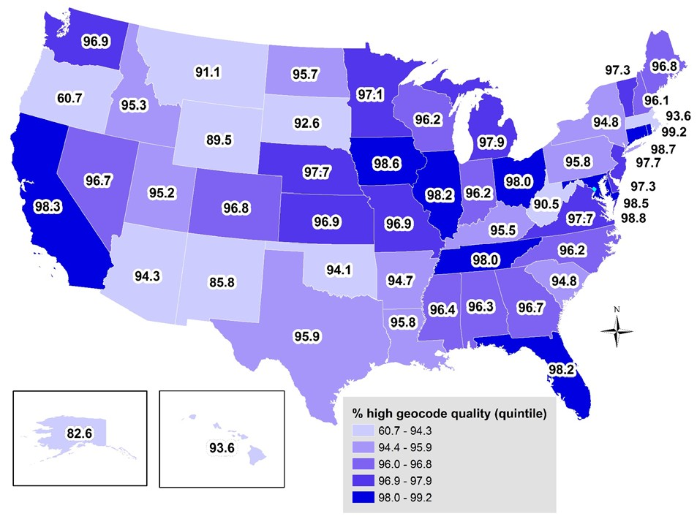






Geographic distribution of geocode quality, mortality data 2010-2015
*
*
*WI and ME: excludes 2010

Slide 30
Methodological Strategy
Phase 1:
Estimate age-specific death rates, m(x) for tracts with minimum populations of 5,000 (aggregate of 6 years of mortality data) and no missing age-specific death counts.
Select tracts with acceptable age patterns, or schedules, of mortality to use as “models” and borrow information for Phase 2 tracts with missing age-specific death counts.
Phase 2:
Estimate Truncated Poisson or Negative Binomial Models to generate predicted m(x) for Phase 1 “model” tracts and extrapolate to Phase 2 tracts.
For Phase 2 tracts with a minimum population size of 5,000 but with missing age-specific death counts, replace missing m(x) with predicted values.
Evaluate and select Phase 2 tracts with acceptable age patterns, or schedules, of mortality.
All Tracts:
Calculate abridged life tables for all tracts with complete age-specific mortality information and acceptable mortality schedules.
Evaluate resulting life tables: explore variance of life table functions, evaluate outliers, compare to US estimates, compare to State level estimates.
35

Slide 31
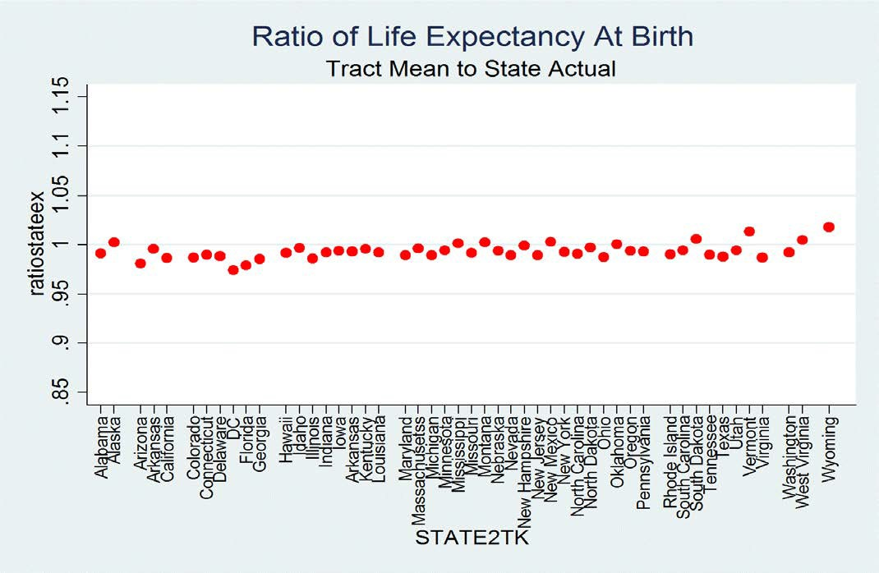
36

Slide 32


SAVE THE DATES!
Early July
Embargoed USALEEP estimates made available to Vital Records Offices
July 18, 2018
Webinar on Life Expectancy at Birth Methodology
July 24, 2018
Communications Webinar for Vital Records Offices
Mid - August
USALEEP Estimates Launch
37

Slide 33
Roll out and Follow Up
Short Term
Proactive or Reactive
Local Health Communication
Local health Support
Who has lead/key players
Long Term
Resource for Access and use
State/local analysis
Fold into community health assessments
Tie into funding priorities
38

Slide 34

Communications Objectives
Raise awareness of new local life expectancy data
Pivot from health gaps illuminated in the life expectancy data to a discussion around taking action to advance health equity
Build knowledge and skills around using community-level data as a complement to other data sources at the state or county level
Share examples of how health departments and other leaders are using life expectancy data to make changes
Encourage organizations and local leaders to facilitate partnerships and advance policy change to improve health using community-level data
Build demand for life expectancy data gathering to continue
39

Slide 35
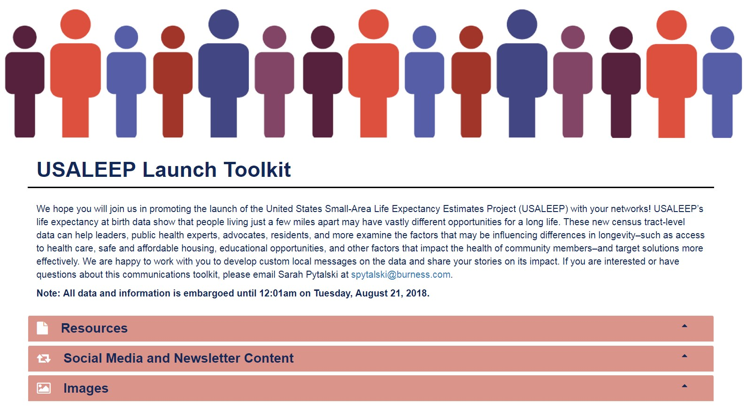
USALEEP Tool Kit http://usaleep.nptoolkit.org/
40

Slide 36

Many factors affect health, such as opportunities for quality education, good jobs, safe neighborhoods, affordable housing, reliable public transportation, and access to health care, social services, healthy food, and child care.
41

Slide 37
These new data can help pinpoint disparities in life expectancy at birth and start a conversation that leads to action.
There is no one-size-fits-all approach.
Every community will prioritize different issues based on its challenges and opportunities.
42

Slide 38
Where we live makes a difference in how well and how long we live. We know that not everyone has the same opportunity to be healthy where they live. These data—life expectancy at birth—show that people living just a few miles apart may have vastly different opportunities for a long life.
These differences in health aren’t unique to big cities, small towns or rural areas—they’re a pattern across America.
43

Slide 39
Ideas for Using the Data
Community Members
Guide conversations with each other
Talk with elected officials about where they want to see change:
Transportation
Access to healthy food
Affordable housing
Education & job training
Policymakers Better understand disparities Make decisions about:
Transportation
Grocery stores
Physical activity requirements
Healthy school meals
Community safety
Health care access
44

Slide 40
Ideas for Using the Data,
Co
nt’d
Community Development Officials
Determine which neighborhoods need investment to fund health clinics, preschools, community centers, housing, etc.
Public Health or Health Care Workers
Inform community health assessments
Help direct limited dollars to where there is the most need
45

Slide 41
Track Impact
Short Term Effect
Catalog Reactions Responses Track Use State and Local Research use
46

